Slide 1
Sprint presentation
Kathryn Schauer, Nicholas Smythe, Joseph Scerbo

Slide 2
Challenges faced
Finding time for all of us to work on the project together
Using the contributors function on github
Coding and testing the sprint robots
Making sure the robot was charged

Slide 3
Roles of each team member
Katie
Writing the summary, gantt chart, requirements and table, algorithm, submitting the design document
Nick
Signing out the robot, coding the robot, testing the robot and making sure it works properly
Joe
Making the flowchart, writing about the hardware and software

Slide 4
What we learned about software engineering
Working as a team and communication - splitting up parts
What a system design document is and how to format one
How computer science relates to software engineering
How to apply coding to a project and not use code at the same time

Slide 5
What we would do differently
Work on project earlier instead of last minute
Meet up as a team in person more
Using the contributors function on github instead of google docs
If had an option we would use a different room to have more exact results for coding

Slide 6
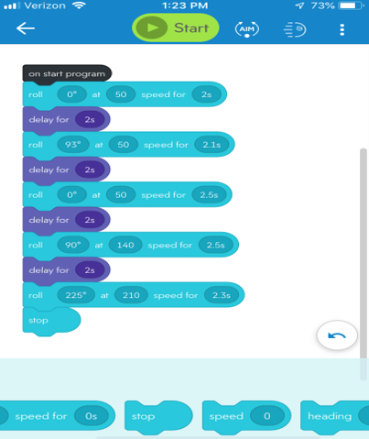
Code for Sprint 3

